Slide 1
Assured Insurance
Raj Shah and Jackie Lu
Einstein Bot, Tableau, HTML, Pandas
Create solutions that help patients better understand their care
Create solutions that address the need to keep costs down for patients

Slide 2
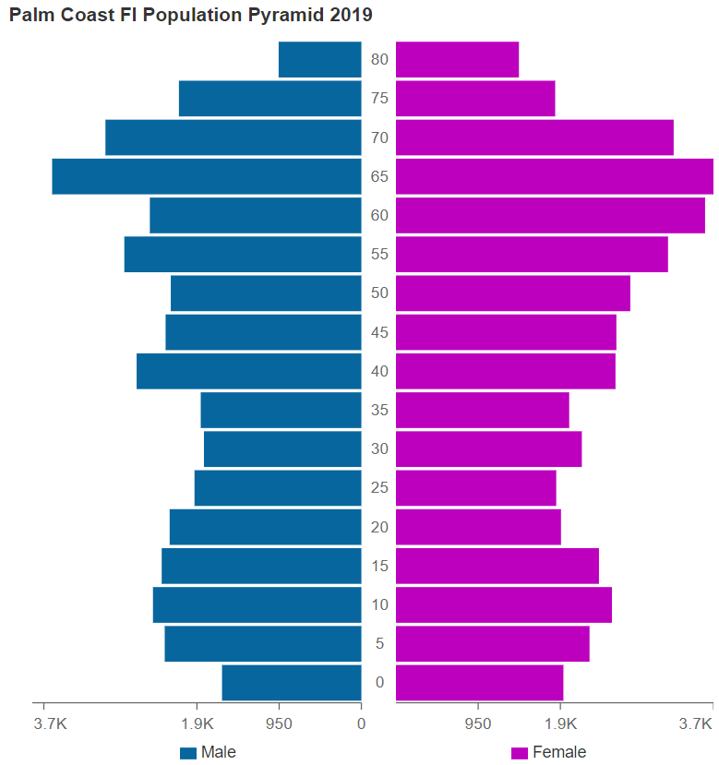
Narrative
Market included
Notes:
In this US national survey study of 506 insured adults, 29.6% reported having delayed or foregone care because of cost. Higher health insurance literacy was associated with a lower likelihood of delayed or foregone care owing to cost for both preventive and nonpreventive care.
It appears that to improve appropriate use of recommended health care services, including preventive health services, clinicians, health plans, and policymakers may need to communicate health insurance concepts in accessible ways regardless of individuals’ health insurance literacy.
https://jamanetwork.com/journals/jamanetworkopen/fullarticle/2714507
Plain language communication may be able to improve patients’ understanding of services exempt from out-of-pocket costs.

Slide 3
Solution
Notes:
We created a non-profit start up aimed to providing health insurance literacy to people everywhere, starting with the people of Palm Coast. Assured Insurance hosts a website geared to educating them on fundamentals of health insurance, the expected charge for medical statements, and how to dispute charges you believe are unfair. HTML was used to generate a

Slide 4
Demo

Slide 5
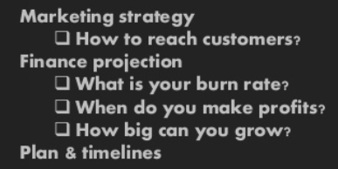
Business Model
Execution 1

Slide 6
Future implementation
Execution 2
Mobile app
Standardized education platform for insurance literacy
Knowledge, Information Seeking, Document Literacy, Cognitive Skills
Modeling projected costs of treatment in comparison to today

